Slide 1
N.JAYACHITRA BE CSE EXPLORTORY DATA ANLAYSIS
& MACHINE LEARNING PRECTION

Slide 2

BREAST CANCER PRECTION
1.EXPLORATORY DATA ANLAYSIS
2.DATA PREPROSSING
3.DATA VISUALITION
4.MACHINE LEARNING
5.LOGISTIC ALOGORITHM & PRECTION
6.CONCLUSION

Slide 3
EXPLOTARY DATA ANALYSIS
Exploratory Data Analysis (EDA) is an approach to analyze the data using visual techniques.
It is used to discover trends, patterns, or to check assumptions with the help of statistical summary and graphical representations.
Getting a better understanding of data 2 Identifying various data patterns 3 Getting a better understanding of the problem statement

Slide 4
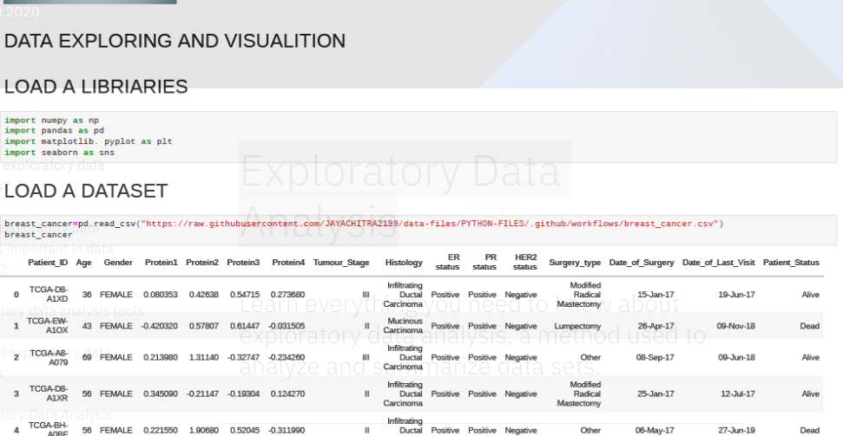
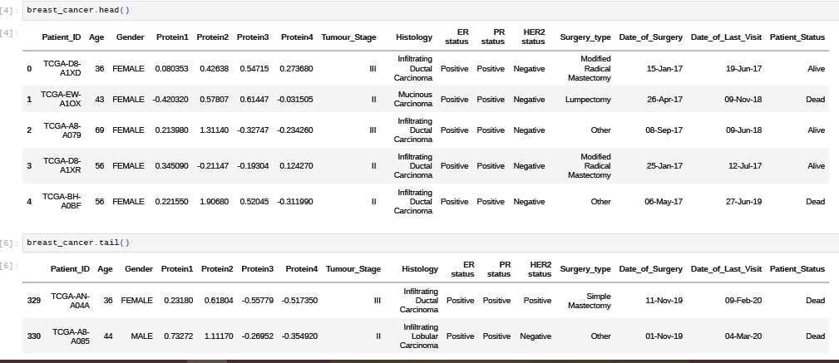
Exploratory Data Analysis

Slide 5
DATA PREPROCESSING
Data preprocessing, a component of data preparation, describes any type of processing performed on raw data to prepare it for another data processing procedure.
It has traditionally been an important preliminary step for the data mining process.
Load data in Pandas.
Drop columns that aren't useful.
Create dummy variables.
Take care of missing data.

Slide 6
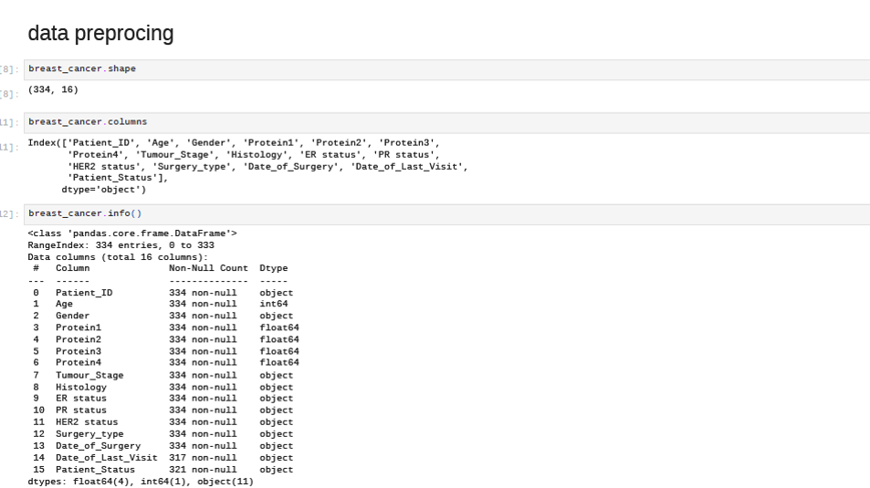
DATA PREPROSSING

Slide 7
DATA VISUALITION
Data visualization is defined as a graphical representation that contains the information and the data.
By using visual elements like charts, graphs, and maps, data visualization techniques provide an accessible way to see and understand trends, outliers, and patterns in data.
The main goal of data visualization is to make it easier to identify patterns, trends and outliers in large data sets.

Slide 8
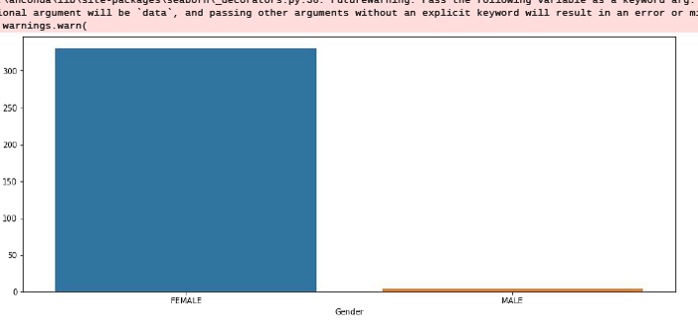
DATA VISUALATION
Breast cancer is compare Male and female

Slide 9
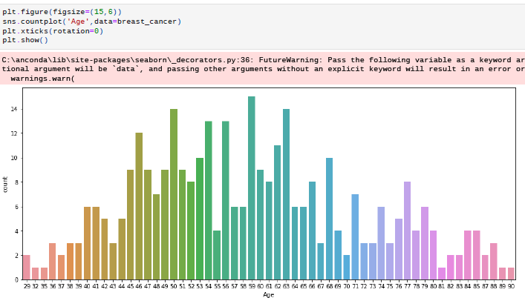
DATA VISUALITON Breast cancer Age wise visualition

Slide 10
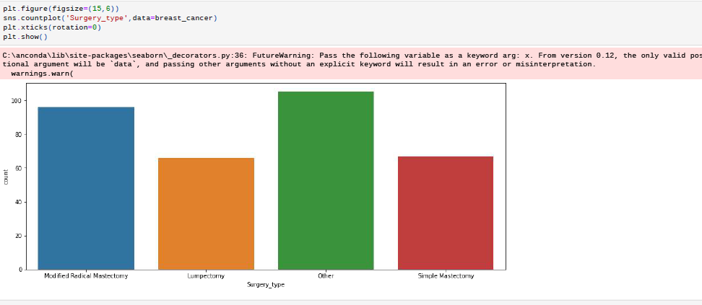
DATA VISUALITION Breast cancer surgery type

Slide 11
MACHINE LEARNING
Machine Learning is making the computer learn from studying data and statistics.
Machine Learning is a step into the direction of artificial intelligence (AI).
Machine Learning is a program that analyses data and learns to predict the outcome.

Slide 12
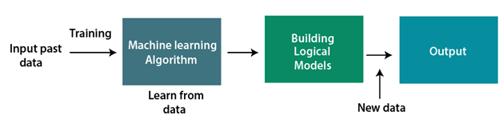
MACHINE LEARNING WORK

Slide 13
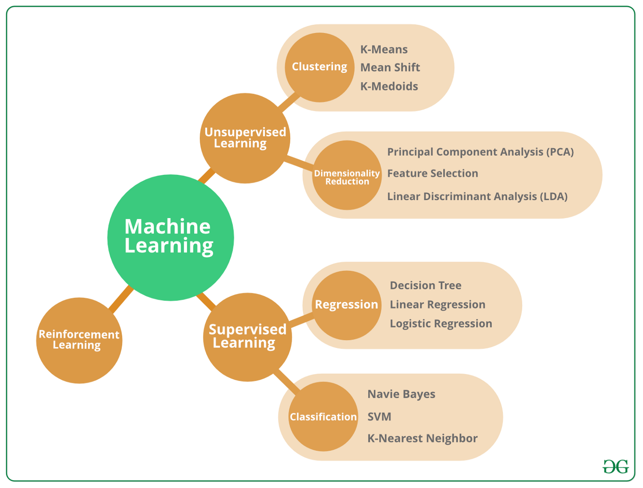
TYPES OF ML
There is a 3 Types

Slide 14
Logistic regression machine learning
Logistic regression is one of the most popular Machine Learning algorithms, which comes under the Supervised Learning technique.
It is used for predicting the categorical dependent variable using a given set of independent variables.
Logistic regression predicts the output of a categorical dependent variable.

Slide 15
Logistic Regression
Logistic regression is a statistical analysis method to predict a binary outcome, such as yes or no, based on prior observations of a data set.
A logistic regression model predicts a dependent data variable by analyzing the relationship between one or more existing independent variables.
Logistic regression is used across many scientific fields.

Slide 16
Logistic regression Steps
Model the building
Plot Precision vs Recall curve
Test accuracy of the result(Creation of Confusion matrix)
Visualizing the test set result.

Slide 17
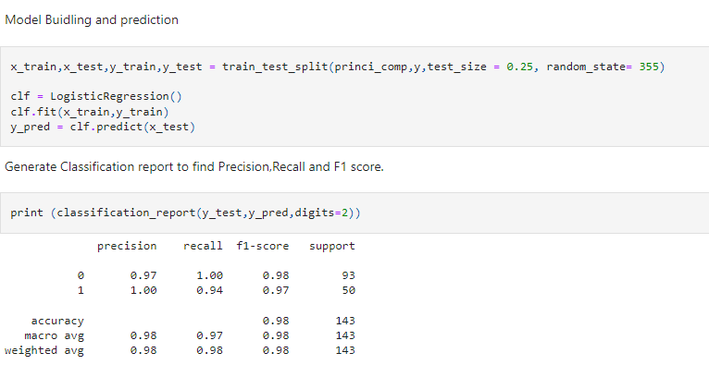
Model The Buliding
Perform machine learning optimisation.
Deploy the model.

Slide 18
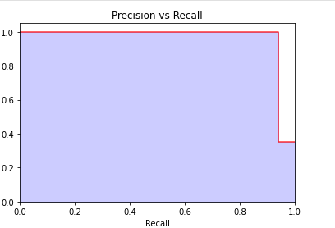
. Plot Precision vs Recall curve
It is important to note that Precision is also called the Positive Predictive Value (PPV).
Recall is also called Sensitivity, Hit Rate or True Positive Rate (TPR).

Slide 19
Test accuracy of the result(Creation of Confusion matrix)
A confusion matrix is a table that is used to define the performance of a classification algorithm.
A confusion matrix visualizes and summarizes the performance of a classification algorithm
Given is an example to know the terms
True Positive, True Negative, False Negative, and True Negative. True Positive: You projected positive and its turn out to be true.

Slide 20
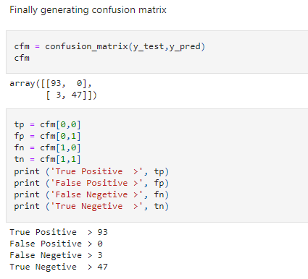
Test accuracy of the result(Creation of Confusion matrix)

Slide 21
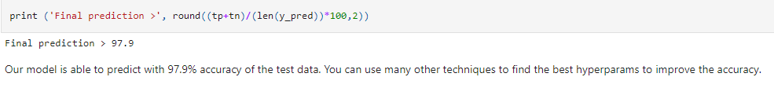
Visualizing the test set result

Slide 22
CONCLUSION
I have using in Logistic regression model it is a best model in my idea.
Our model is able to predict with 97.9% accuracy of the test data. You can use many other techniques to find the best hyperparams to improve the accuracy.
Maintain a healthy weight. If your weight is healthy, work to maintain that weight.
Be physically active
Limit postmenopausal hormone therapy.

Slide 23


